Slide 1

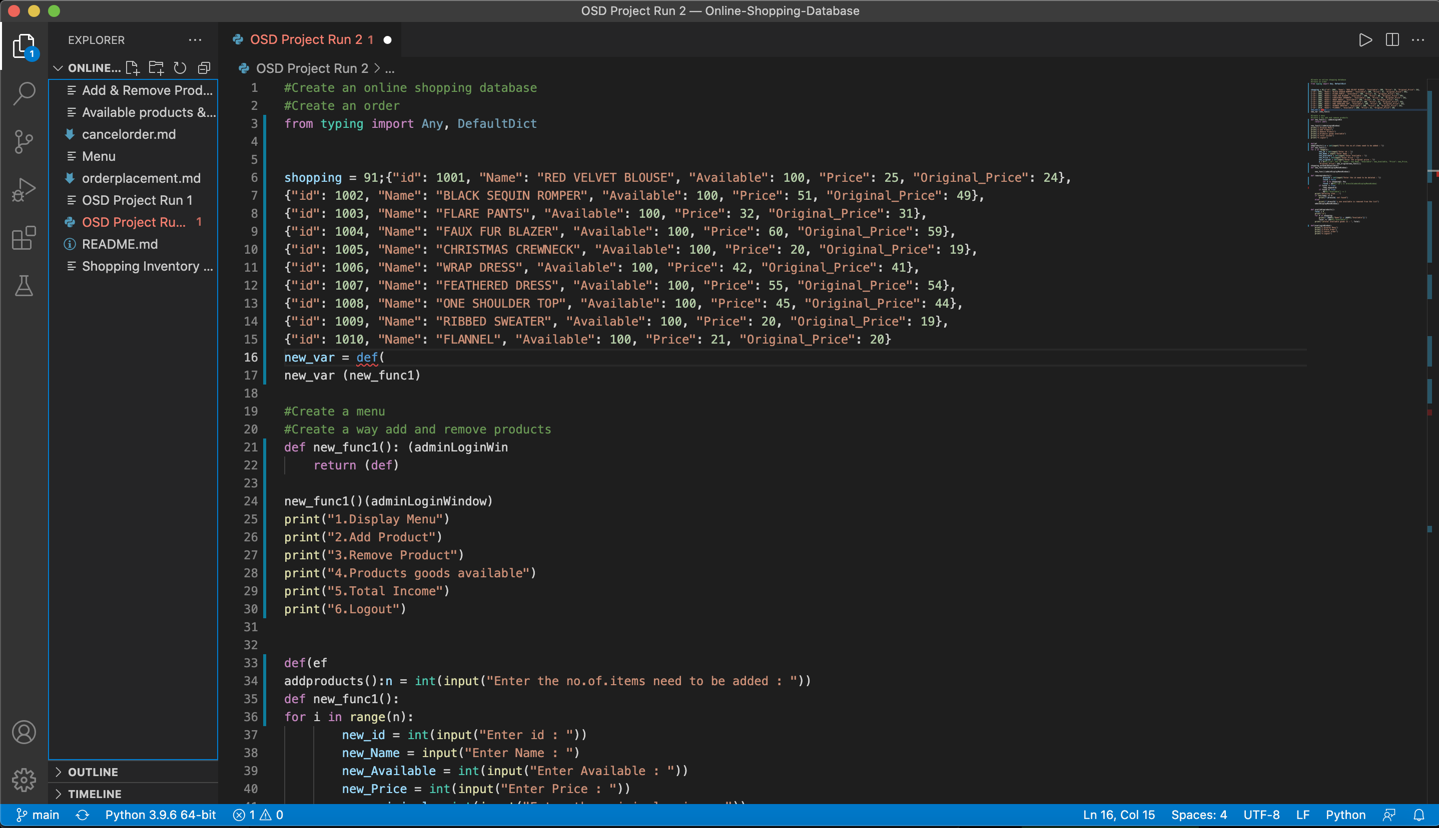
Online shopping Database
Caroline Lumpkin
A program that allows you to shop online, place an order, and cancel an order.

